Slide 1


(MANSATUKA – ONLINE QUEUE MANAGEMENT SYSTEM)
DONE BY:
MAJED ABU OMAIR
SUPERVISED BY:
DR. ALI AL-IBRAHIM

Slide 2




Introduction
The Mansatuka Online Queue Management System is a web-based platform that replaces physical queues with a virtual appointment system. It allows users to book services remotely, reducing on-site waiting and improving efficiency. The system is designed for service-based organizations and emphasizes accessibility, bilingual support, and user convenience.

Slide 3


Background
Queue Management Systems are used to control customer flow and improve service efficiency. Traditional systems depend on physical presence and manual processes, often causing delays and congestion. Digital QMS solutions use online scheduling and real-time data to provide more organized and transparent service delivery.

Slide 4

Problem statement
Conventional queuing methods lead to long waiting times, overcrowding, and poor customer experience. Customers often lack information about queue status and service timing, while organizations struggle with inefficient staff utilization during peak hours. These challenges highlight the need for a digital alternative.

Slide 5

Main Objective
The project aims to implement an online appointment and queue management system that streamlines service delivery by replacing physical queues with scheduled virtual access.

Slide 6

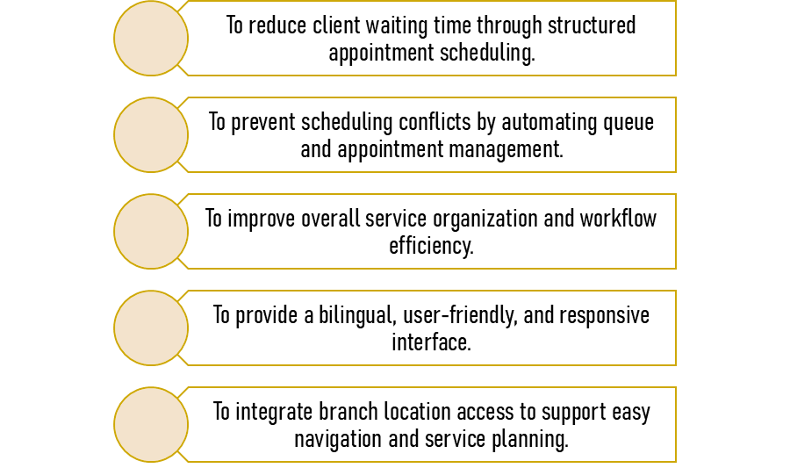


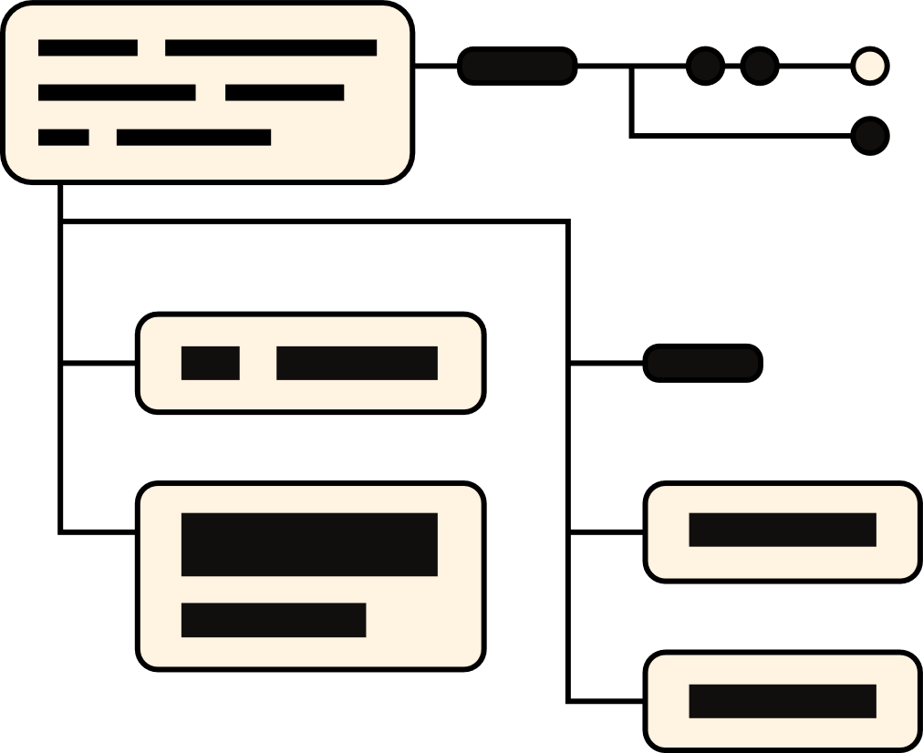
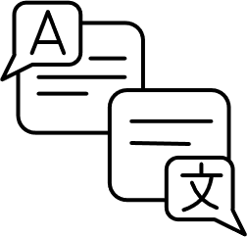
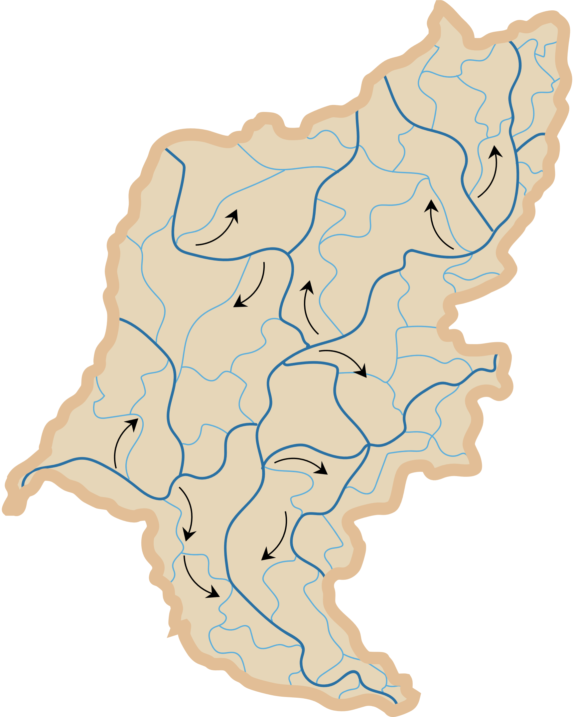
specific Objectives

Slide 7
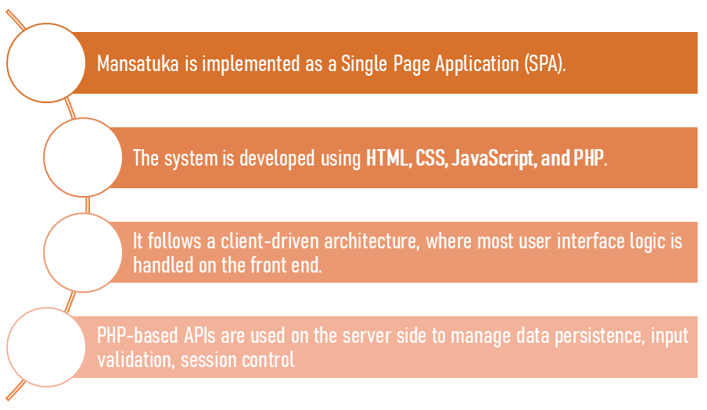



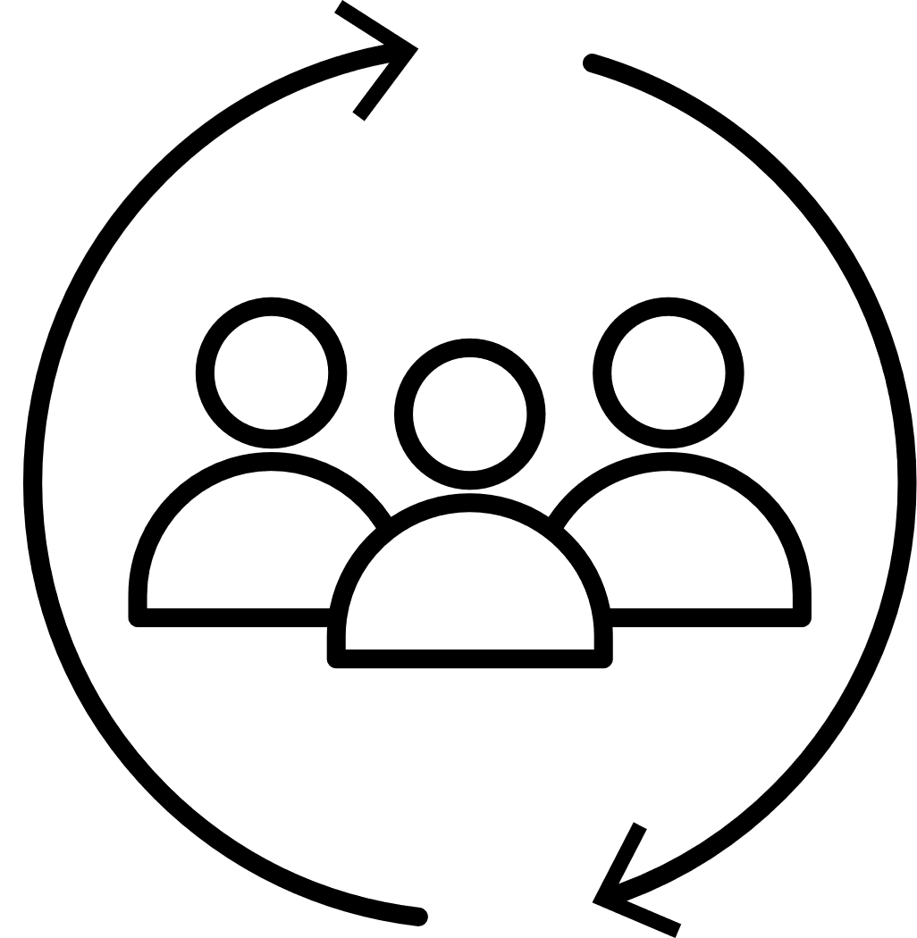

System Architecture

Slide 8

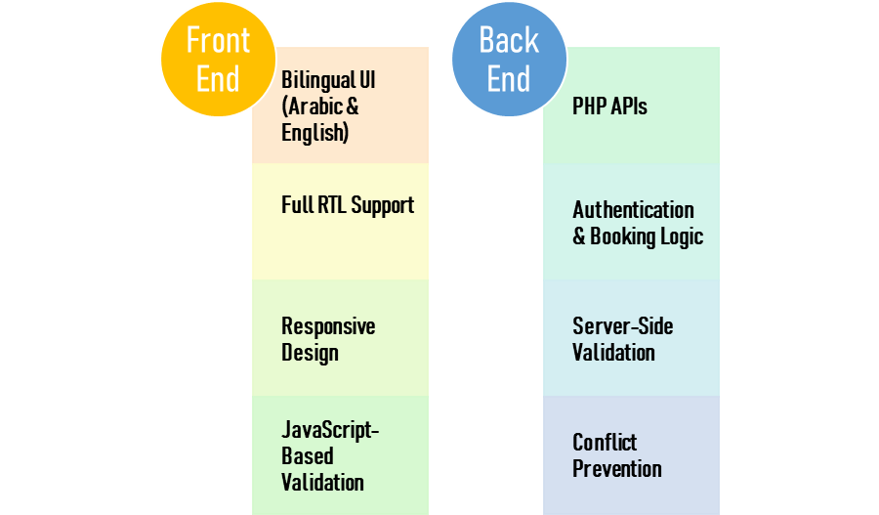
Front-End & Back-End Design

Slide 9
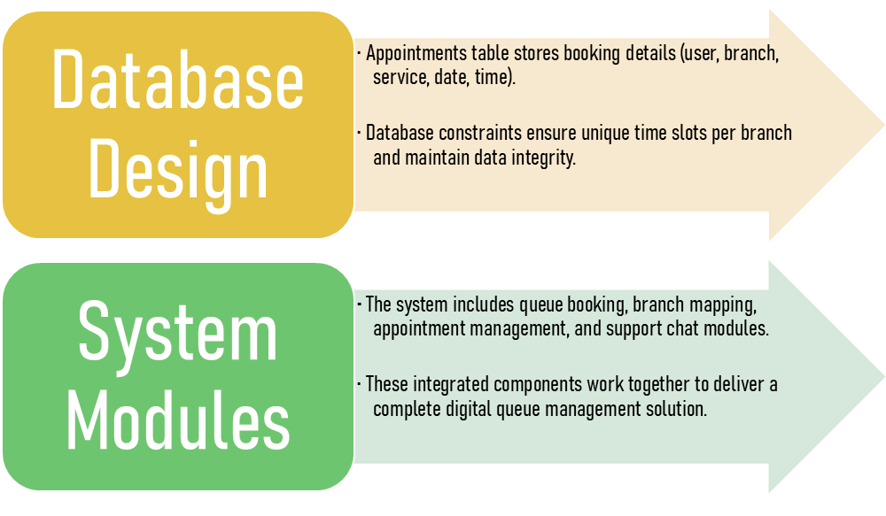
System Architecture: Data & Modules

Slide 10

Implementation
The system was developed and tested using the XAMPP environment, which integrates Apache, MySQL, and PHP.
XAMPP was chosen for its simplicity, cross-platform compatibility, and suitability for academic projects. It enabled efficient local testing of backend APIs, database operations, and session management.

Slide 11
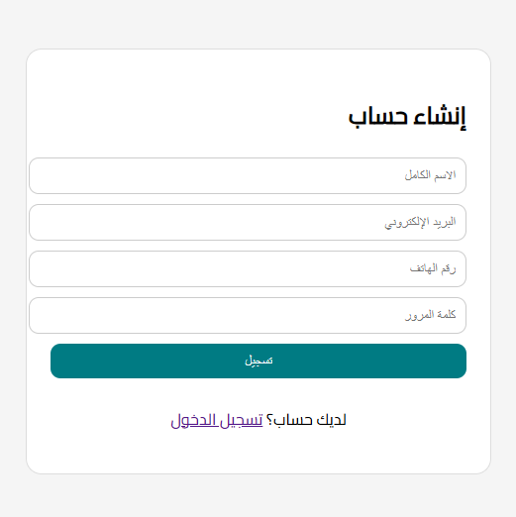
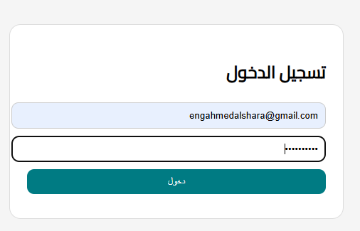
User Authentication / Sign-Up Page
User Registration
Users create an account by entering their email address and password
Information is securely stored in the database
Enables access to booking, my bookings, and support features

Slide 12

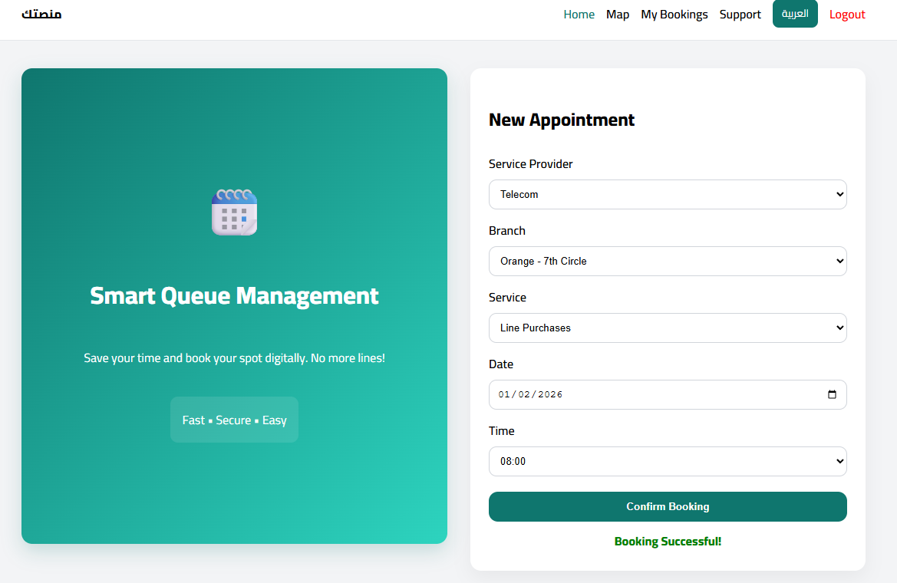
Functional Implementation
1. Booking Module
Users select branch, service, date, and available time slot
Real-time availability check prevents double booking
Instant confirmation displayed

Slide 13
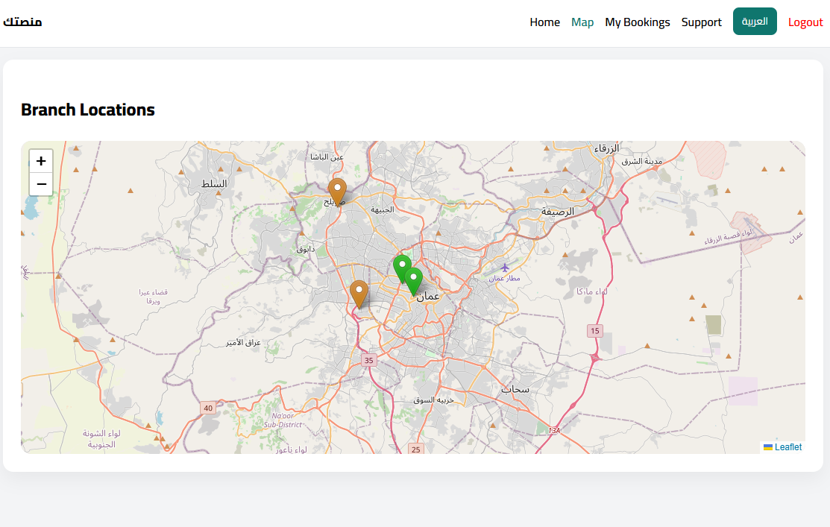
Functional Implementation
2. the map module
Displays all bank branch locations on an interactive map
Helps users assess accessibility before booking an appointment
Integrates with the booking module so users can easily select the nearest or most convenient branch
Enhances user experience by combining location data with scheduling options

Slide 14
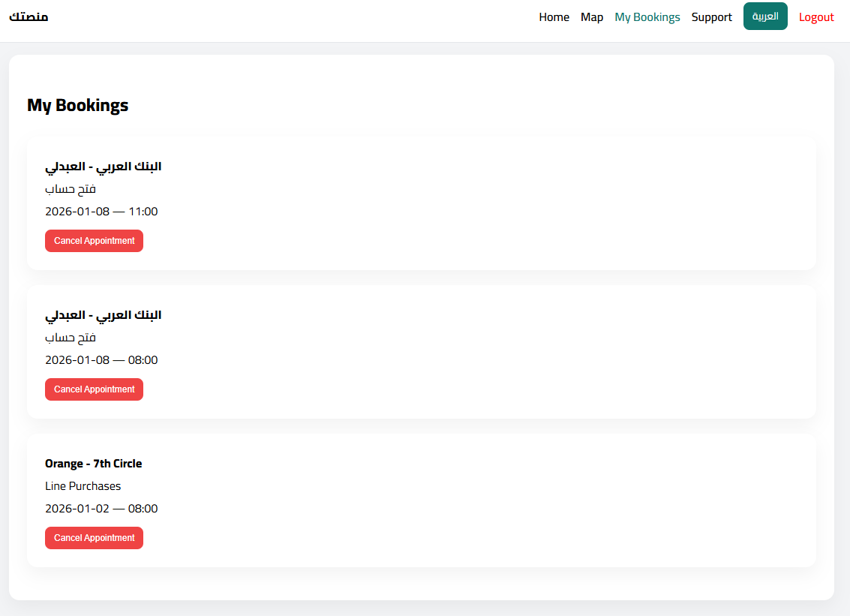
Functional Implementation
3. My Bookings Module
View, cancel, or modify appointments dynamically
Changes reflected immediately in the system

Slide 15
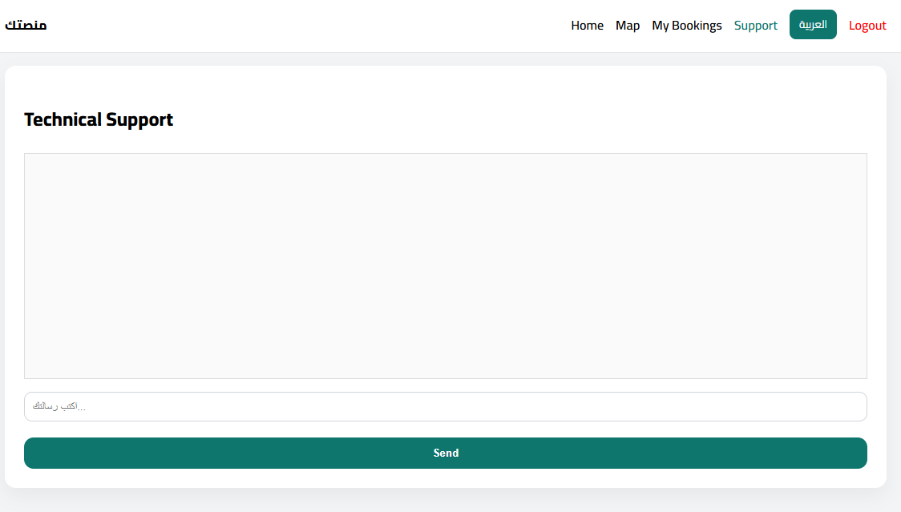
Functional Implementation
4. Support Chat Module
Simulated chatbot interface for user engagement and support
Foundation for future AI-powered features

Slide 16

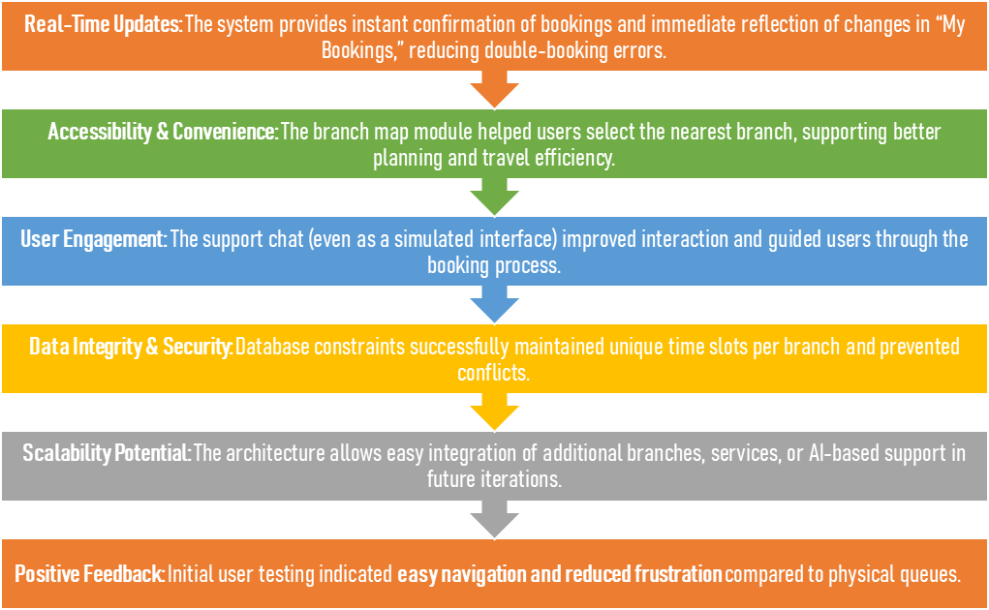
Results

Slide 17


Conclusion
Mansatuka successfully demonstrates a web-based, appointment-driven Queue Management System that addresses the limitations of traditional queues. While the current system uses local storage and a simulated chatbot, future work includes centralized backend deployment, SMS or push notifications, and the integration of predictive analytics and machine learning to optimize scheduling and demand forecasting.

Slide 18
References
Gross, D., Shortle, J., Thompson, J., & Harris, C. (2008). Fundamentals of Queueing Theory.
Larson, R. C. (2017). The Psychology of Waiting Lines.
Maister, D. H. (2005). The Psychology of Waiting.
Dabholkar, P. A., & Bagozzi, R. P. (2002). Technology-Based Service Encounters.
Haksever, C., & Render, B. (2012). Service Management and Operations.
Flanagan, D. (2020). JavaScript: The Definitive Guide.
Silberschatz, A., Korth, H., & Sudarshan, S. (2020). Database System Concepts.
Haklay, M., & Weber, P. (2008). OpenStreetMap: User-Generated Street Maps.

Slide 19
Thank
You
FOR YOUR ATTENTION

